Slide 1


IDS 1721
Computing and Problem Solving for STEM Chapter 07
The second Dimension
Lesson 01

Slide 2
Course Learning Outcomes
Describe the fundamentals of the computing environment for problem-solving using variables, arrays, and functions.
Interpret computing concepts and distinguish between environment provided functions and user-defined functions.
Utilize programming concepts such as iteration processes, conditional statements, and logical constructs to design solutions to diverse problems.
Implement pseudo code into working code using structured programming principles.
Formulate and refine algorithms to solve problems in STEM Fields
Communicate and comment on code and solutions to multi-step problems through careful, organized, and well-annotated work.

Slide 3
Chapter 07: Overview
Learn the concepts for:
Two-dimensional arrays, matrices, rows, columns, matrix operations, submatrices, Markov chains, visualization, grid generation, cross sections, shading, function as parameters, simulation on a grid
Learn language features:
Matrix: A two-dimensional array
A matrix of 0’s and 1’s: zeros, ones
Matrix with random numbers: randn
Matrix dimensions: size
Drawing a contour plot: contour
Drawing a color-coded mosaic of tiles: pcolor

Slide 4
Chapter 07: Videos
Video 10. Creating Arrays
How to create arrays of numbers.
Video 11. Array Addressing
How to access subarrays.
Video 12. Basic Mathematical Operations on Arrays
How to write simple expressions that perform a mathematical operation on all elements of a vector. Vectorized code performs arithmetic (and relational and logical) operations on multiple elements of an array in one statement.

Slide 5
Chapter 7: The Second Dimension
As we have said before, the ability to reason at the array level is very important in computational science. This is challenging enough when the arrays involved are linear, i.e.,one-dimensional.
Now we consider the two-dimensional array using this chapter to set the stage for more involved applications that make use of this structure. The term “matrix” will be used interchangeably with “two-dimensional array.”
To get acquainted with double subscripts and the jargon of rows and columns, we consider a modeling problem in which a matrix interacts with a sequence of vectors. The resulting simulation predicts how the populations vary with time, a type of probabilistic modeling that is ubiquitous in science.

Slide 6
Chapter 7: The Second Dimension
Next we turn to the problem of visualizing a function of two variables. Contour plots and cross sections are key and each requires the systematic sampling of the underlying function. In programming terms, our task is to extend our ability to work with linspace and plot.
Lastly we take up the matter of simulation on a two-dimensional grid. This will provide yet another snapshot of the boundary between the continuous and the discrete. We simulate the cooling of a rectangular plate, something that requires discretization in both space and time. There are Δx’s, Δy’s, and ΔT ’s.

Slide 7
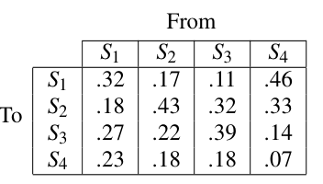
Problem Statement: From Here to There
Suppose we have four inhabited islands S₁, S₂, S₃, and S₄. (For example, Oahu, Kauai, Maui, and Lanai.) It is observed that each year the inhabitants move from island to island.
Data is gathered to reveal details about the migration pattern, as shown. The probability of moving from S₃ to S₄ is .18 (18%), the probability of “staying put” if you live in S₂ is .43, etc. Assume that four million people are equally distributed among the four islands in year Y.
Estimate the distribution of population in year Y +5.

Slide 8
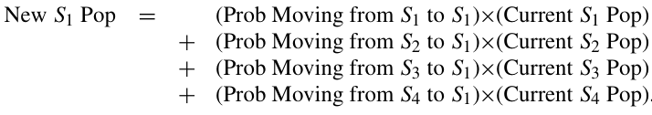
Program Development
To get a feel for what is involved in this problem, let us predict the population of island S₁ after one time step (one year). We must account for the contributions from each of the four islands and so:

Slide 9
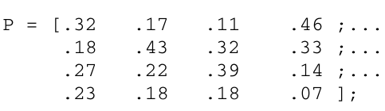
Program Development
To make this precise, suppose that x is a 4-by-1 array with the property that the value of x(i) is the number of people living on island S_{i} at the start of a given time step. Likewise, let y be a 4-by-1 array with the property that the value of y(i) is the number of people living on island S_{i} at the end of a given time step. We can encode the transition probabilities as follows:
The variable P is a two-dimensional array, also referred to as a matrix.

Slide 10
Program Development
The variable P is a two-dimensional array, also referred to as a matrix. Whereas a single subscript is needed to identify a vector component, a pair of subscripts is required to locate a matrix component. Thus, P(2,3) has the value .32. The first subscript pinpoints the row, while the second is used to specify the column. The matrix P is a 4-by-4 matrix (4 rows by 4 columns).
The square bracket assembly technique is convenient for the initialization of small matrices.
Notes:
The square bracket assembly technique is convenient for the initialization of small matrices. Note that
semicolons are used to separate the values from each row.

Slide 11
Program Development
In our application, the value of P(i,j) is the probability of moving from S_{j} to S_{i}. Thus,
assigns to y(1) precisely the new S₁ population.
Notes:
The square bracket assembly technique is convenient for the initialization of small matrices. Note that
semicolons are used to separate the values from each row.

Slide 12
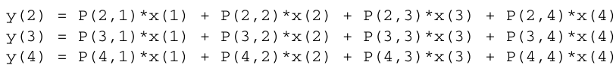
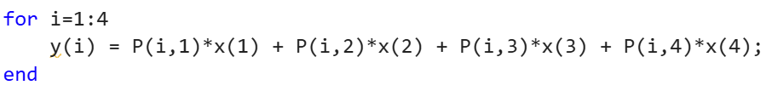
Program Development
In our application, the value of P(i,j) is the probability of moving from S_{j} to S_{i}. Thus,
Then, for the other islands:
Using a loop we have:
Notes:
The square bracket assembly technique is convenient for the initialization of small matrices. Note that
semicolons are used to separate the values from each row.

Slide 13
Program Development
Obviously, we could repeat this update process five times and thereby obtain the population distribution after five “time steps.”
However, instead of writing a script that solves this specific problem, it is more instructive to develop a general framework that can be used to carry out arbitrarily large “island-hopping” simulations.

Slide 14
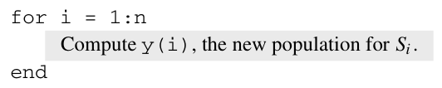
Program Development
To that end, assume that we have islands S₁,...,S_{n} and that the initial length-n population distribution vector x and the n-by-n transition probability matrix P are set up. The updating process may proceed as follows:
At the end, we could create a table
for year 1, another for year 2, and
so on, until year 5 for a 3D matrix,
if we wanted!

Slide 15
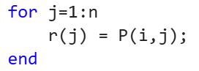
Program Development
It is clear from our n = 4 example that the computation of y(i) is a length-n summation that involves the transition probabilities from the ith row of P and the values in the current population vector x. We can use our one-dimensional vector expertise to solve this problem.
We first copy the values from the ith row of P into a vector r:
Notice how only the column index varies during the loop—all data come from the ith row of P.

Slide 16
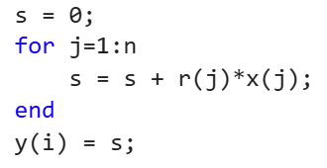
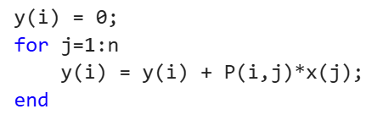
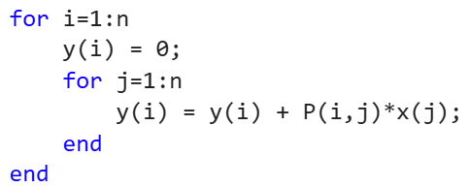
Program Development
We next perform the required summation using a familiar one-dimensional summation strategy, assigning the final sum to y(i):
and then
equivalent to
This kind of nested-loop computation is typical in applications that involve two-dimensional arrays.

Slide 17
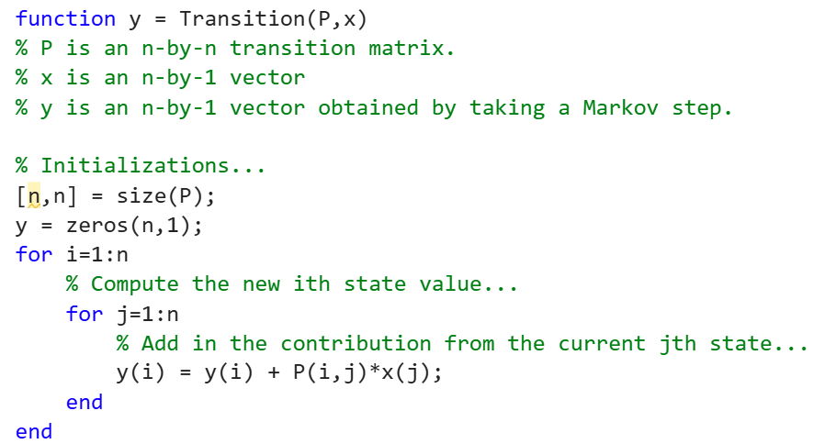
Program Development
We encapsulate the transition process with a function for the 5 steps:

Slide 18
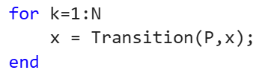
Program Development
In this setting we refer to x and y as state vectors because collectively, their components tell us everything about the state of the “system,” i.e., how many inhabitants there are on each island.
The dimensions of a matrix can be obtained using the built-in function size. Notice that we are choosing to represent x and y as column vectors.
With function Transition available it is an easy matter to repeat the transition process. The fragment calls the function several times

Slide 19
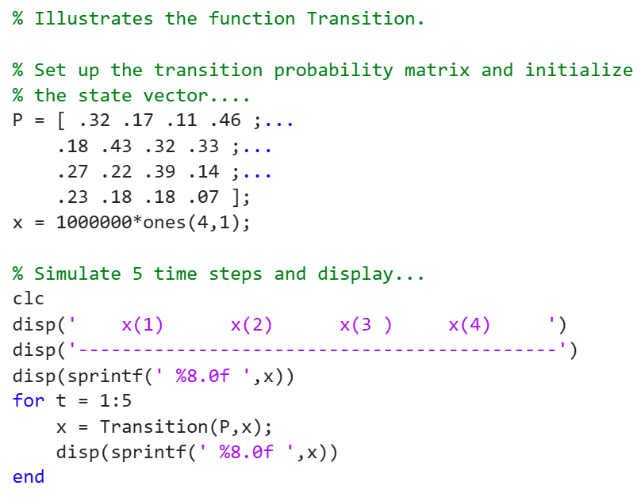
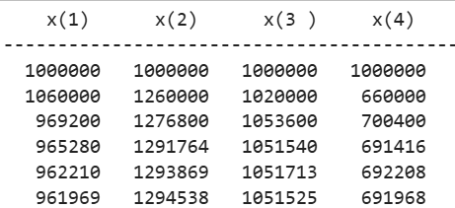
Final Code

Slide 20
Talking Point: Markov Chains and Stationary Vectors
The type of discrete modeling illustrated in this section is referred to as a Markov chain. Markov chain modeling is common throughout science and engineering. The state transition matrix P that underlies the process has several important properties.
Most interesting is the fact that there is (almost always) a vector x such that the value of Transition(P,x) is x. This means that once the system reaches the state characterized by x, then it “stays there,” i.e., the system has reached a steady state.

Slide 21
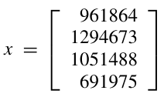
Talking Point: Markov Chains and Stationary Vectors
The vector x is called the stationary vector. For our island-hopping problem, the stationary vector is approximately
We have normalized x so that its entries sum to four million, the total size of the population. Once this distribution is achieved, the island populations remain the same from year to year.

Slide 22
MATLAB Review
A two-dimensional array has a certain number of rows and a certain number of columns. To say that an array is m-by-n is to say that it has m rows and n columns.
A pair of subscripts are required to pinpoint an entry in a two-dimensional array:

Slide 23
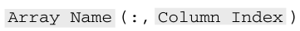
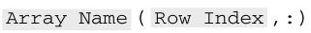
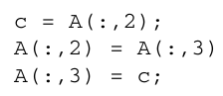
MATLAB Review
Referencing Whole Rows and Columns
A colon all by itself in a subscript position can be used to reference an entire row or column. Thus,
names the column prescribed by the column index while
names the row prescribed by the row index. The fragment
swaps columns two and three in the array A. For this to be legal, A would have to be a matrix with at least three columns.

Slide 24
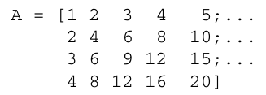
MATLAB Review
A small two-dimensional array can be set up by specifying its values row by row. The rows are separated by semicolons and the whole thing is enclosed within square brackets, e.g.,
Readability is enhanced by spreading the statement over several lines thereby highlighting the row and column structure:

Slide 25
MATLAB Review
If m and n are initialized integers, then A = zeros(m,n) assigns to A the m-by-n matrix of zeros, while A = ones(m,n) assigns to A the m-by-n matrix of ones. Likewise, A = rand(m,n) assigns to A the m-by-n matrix of random numbers using the uniform distribution, while A = randn(m,n) assigns to A the m-by-n matrix of random numbers from the normal distribution.

Slide 26
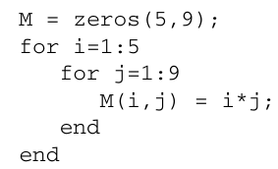
MATLAB Review
Classical Matrix Setup
In setting up matrices it is frequently the case that the (i,j) entry is prescribed by a simple function of i and j. A double loop is typically used to carry out the initialization. For example,
In situations like this it is recommended that the array be initialized to the right size using zeros.

Slide 27
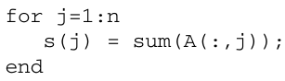
MATLAB Review
If A is a matrix, then [m,n] = size(A) assigns the number of rows in A to m and the number of columns in A to n.
If A is a matrix with n columns, then s = sum(A) is the same as
In other words, s is a vector of column sums.

Slide 28
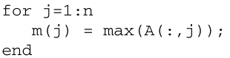
MATLAB Review
If A is a matrix with n columns, then m = max(A) is the same as
In other words, m is the vector of columns max’s. The function min is analogous.

Slide 29
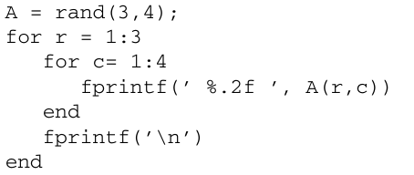
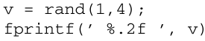
MATLAB Review
Specifying the Print Format for an Array: The elements of an array can be printed using a loop with the usual conversion specifiers, e.g.,
You can also just use one conversion specifier for all the components in a vector (e.g., a row in a matrix):
This will print each of value in vector v to two decimal places.

Slide 30
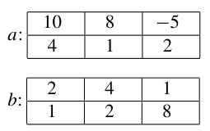
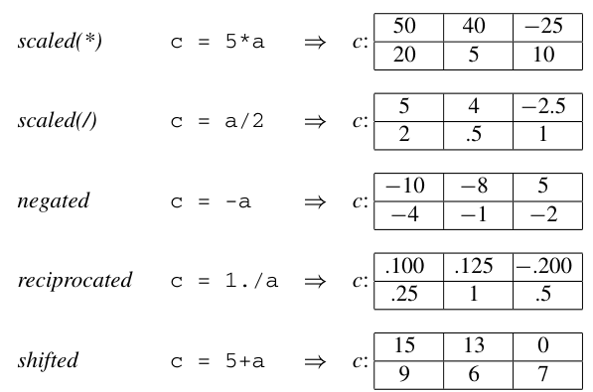
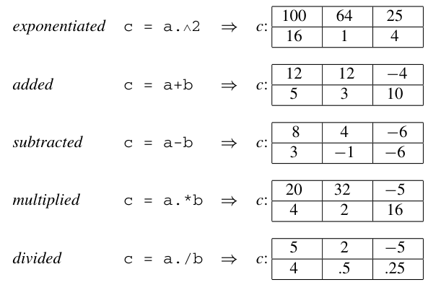
MATLAB Review: Matrix Operations
MATLAB supports matrix-level operations just as it supports vector-level operations, using a and b as examples, the operations are

Slide 31
Questions?

Slide 32
IDS 1721
Computing and Problem Solving for STEM Chapter 07
The second Dimension
Lesson 02

Slide 33
Course Learning Outcomes
Describe the fundamentals of the computing environment for problem-solving using variables, arrays, and functions.
Interpret computing concepts and distinguish between environment provided functions and user-defined functions.
Utilize programming concepts such as iteration processes, conditional statements, and logical constructs to design solutions to diverse problems.
Implement pseudo code into working code using structured programming principles.
Formulate and refine algorithms to solve problems in STEM Fields
Communicate and comment on code and solutions to multi-step problems through careful, organized, and well-annotated work.

Slide 34
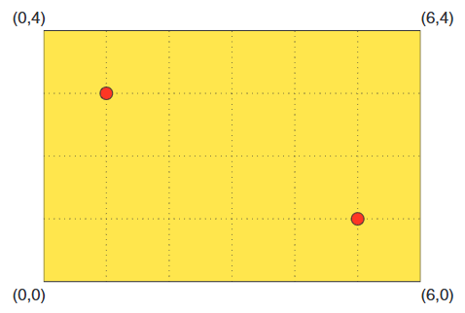
Problem Statement
A rectangular plate has been warmed by a pair of heat sources, one at (1,3) and the other at (5,1). The temperature drops exponentially away from these points and is modeled by
Develop an intuition about the variation of T_{plate} across the plate by displaying a contour plot. In addition, display temperature cross sections corresponding to y = 1, 2, and 3.

Slide 35
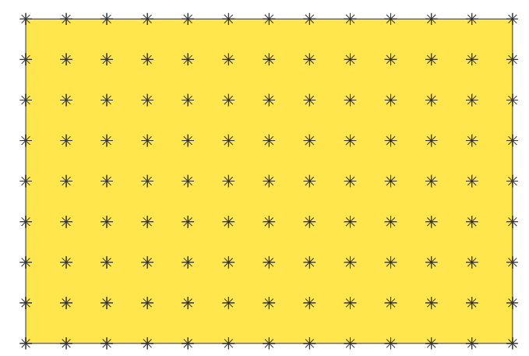
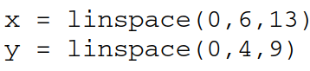
Program Development
As with the display of a single-variable function f(x) using plot, we must work with a ﬁnite set of “snapshots” if we are to visualize a function of the form T_{plate}(x,y).
Our plan is to sample T_{plate} over a grid of “mesh points” that are equally spaced across the plate. A sample grid is depicted in Figure. Observe that the grid is deﬁned by
With points:
Where Δ = 0.5

Slide 36
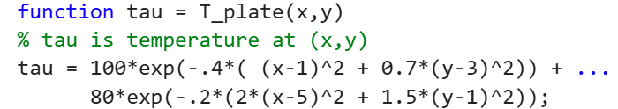
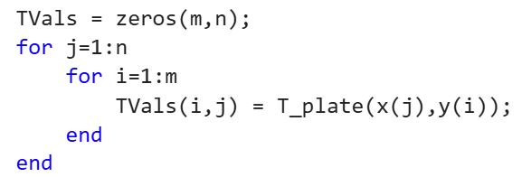
Program Development
Let us assume that these two vectors have been computed and that the following “heat source” function is
In order to produce the required contour plot we must set up a matrix of T_{plate}-evaluations. This boils down to a simple nested loop:
rows:
columns:
Notes:
Conventional f (x,y) notation for continuous functions uses the ﬁrst variable position for the variable that
varies in the left-to-right direction across the plane, i.e., the x-direction. This is in contrast to matrices where
the ﬁrst index position is used to indicate the up-and-down position in the array, i.e., the row. Because of this
“inconsistency,” x-values vary across rows and y-values vary up and down columns. Moreover, y-values
decrease and row index increases. All this means that we must pay attention when we map two-dimensional
information into a matrix.

Slide 37
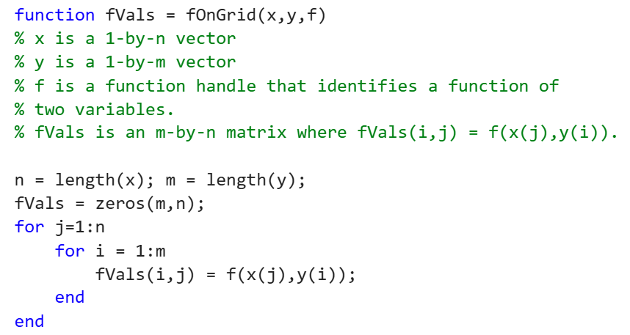
Program Development
For the sake of generality and to support experimentation with alternative temperature distributions, we implement a function fOnGrid that can be used to set up a matrix of function evaluations for an arbitrary f(x,y) deﬁned on an arbitrary rectangular grid.

Slide 38
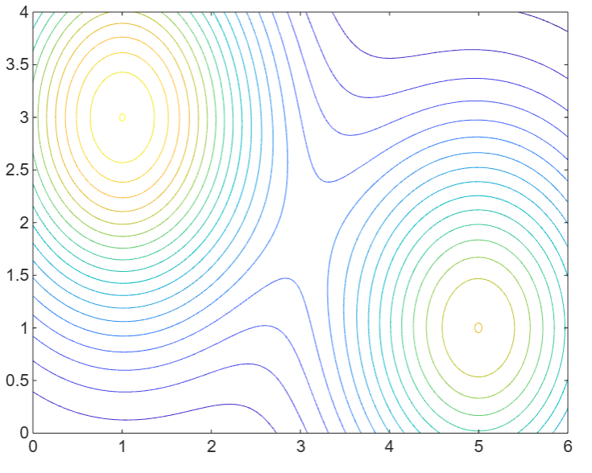
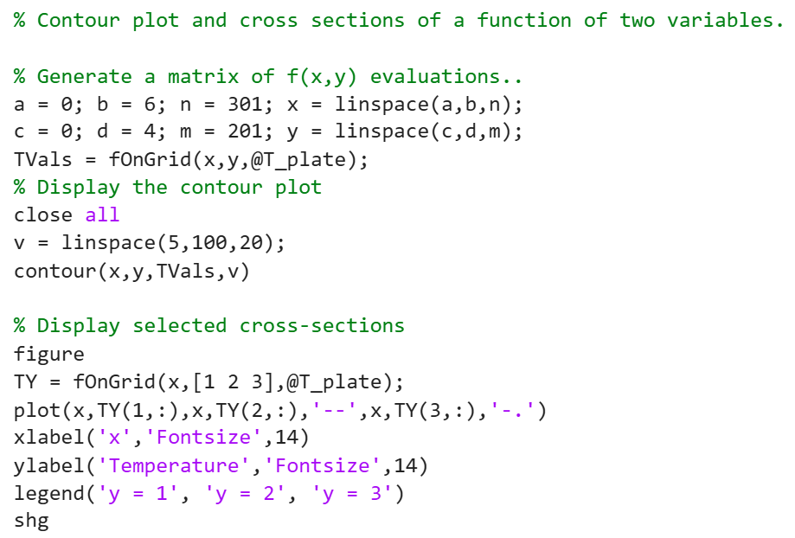
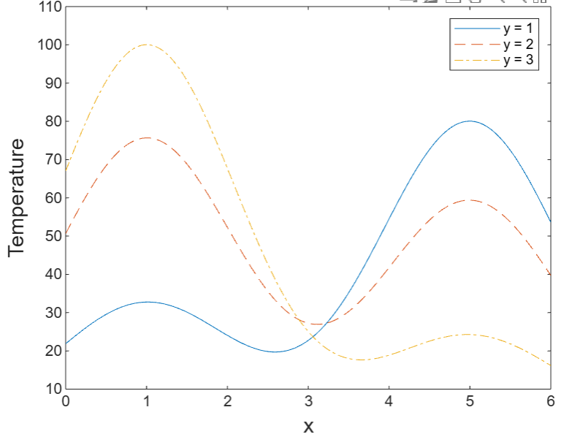
Final Code

Slide 39
Talking Point: Grid Generation
Grid generation refers to the process of distributing a ﬁnite number of points throughout a given geometric domain. The most simple example of this is linspace, which generates an evenly distributed set of points across an interval.
Grid generation is an important tool for bridging the gap between the discrete and the continuous. The simulation of a process over a region can be approximated by tracking what happens at the grid points.
Given these complexities it is no surprise that sophisticated, automatic mesh-generation techniques have been developed. These software tools are built upon deep concepts from computational geometry and an appreciation for how simulation errors correlate with the distribution of the grid points.

Slide 40
MATLAB Review
Functions as Parameters: Suppose MyF is a function that expects a function as one of its input parameters. In a call to MyF, the input function must be identiﬁed by its handle which is done by putting the character “@” in front of its name.
The simplest way to produce a contour plot of a function f(x,y) is contour(x,y,fVals) where x and y are vectors and fVals(i,j) is the value of f at (x_{j} ,y_{i}). The length of x and the length of x must equal the column and row dimension of fVals. It is possible to specify the number of contours and the associated “elevations”.

Slide 41
Questions?

Slide 42
IDS 1721
Computing and Problem Solving for STEM Chapter 07
The second Dimension
Lesson 03

Slide 43
Course Learning Outcomes
Describe the fundamentals of the computing environment for problem-solving using variables, arrays, and functions.
Interpret computing concepts and distinguish between environment provided functions and user-defined functions.
Utilize programming concepts such as iteration processes, conditional statements, and logical constructs to design solutions to diverse problems.
Implement pseudo code into working code using structured programming principles.
Formulate and refine algorithms to solve problems in STEM Fields
Communicate and comment on code and solutions to multi-step problems through careful, organized, and well-annotated work.

Slide 44
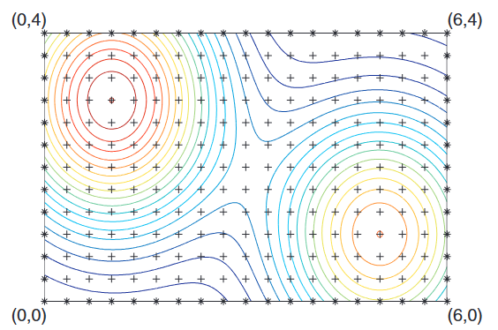
Problem Statement: Cool it!
We continue with the previous problem. In particular, let R be a rectangular plate with vertices at (0,0), (6,0), (6,4), and (0,4) and assume that its temperature distribution is
We want to track how the plate cools when, all of a sudden, the boundary temperature is reduced to 0 and held constant. The proper modeling of the cooling process requires some physics and an ability to solve partial differential equations!. We shall “jump ahead” and work a simple discrete model that can be used to simulate how the temperature changes on an m-by-n grid of points that has been superimposed on the region.

Slide 45
Problem Statement: Cool it!
At the start (t = 0) the temperature at each interior mesh point “+” is given by the function T_{plate}(x,y). The temperature on the boundary mesh points “*” is set to zero. The simulation proceeds to track the cooling process at times t = Δt, 2Δt, 3Δt,... following this rule:
The temperature at an interior mesh point at time (k +1) Δ t is the average of the temperature at its four neighbor mesh points at time k Δt.

Slide 46
Problem Statement: Cool it!
An interior mesh point at (x, y) has
“north” neighbor at (x, y + Δy)
“east” neighbor at (x + Δ x, y)
“south” neighbor at (x, y − Δ y)
“west” neighbor at (x − Δ x, y)
where Δx and Δy are the mesh-point spacings in the x and y directions, respectively. Think of Δ t as a “time step” but do not be concerned about its actual value.
Choose an appropriate number of mesh points and graphically display the cooling process over a reasonable number of time steps

Slide 47
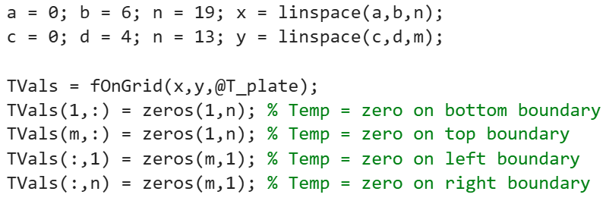
Program Development
The first thing to do is to set up a matrix that houses the grid point temperatures at time t = 0. This is straightforward using the function fOnGrid developed in the previous section. For the example depicted we have
It is assumed that the function T_plate is available.

Slide 48
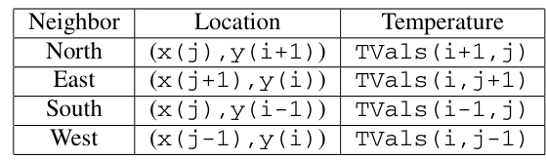
Program Development
The updating of the interior grid point temperatures is given in the language of “neighbors” and this has to be translated into the language of subscripts. For the (i,j)th grid point we have
rows:
columns:
Notes:
Remember, MATLAB uses rows for the first value, and columns for the second value, the rows are changes in the vertical location (y-values) while the columns are the changes on the horizontal location (x-values), so index are switched for the temperature calculation

Slide 49
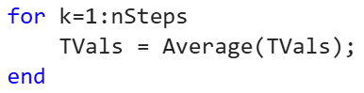
Program Development
Using a nested loop we can visit each interior mesh point and perform the averaging computation. We package the overall cooling step update in the new function Average.
The cooling simulation is tantamount to repeatedly overwriting TVals with Average(TVals):

Slide 50
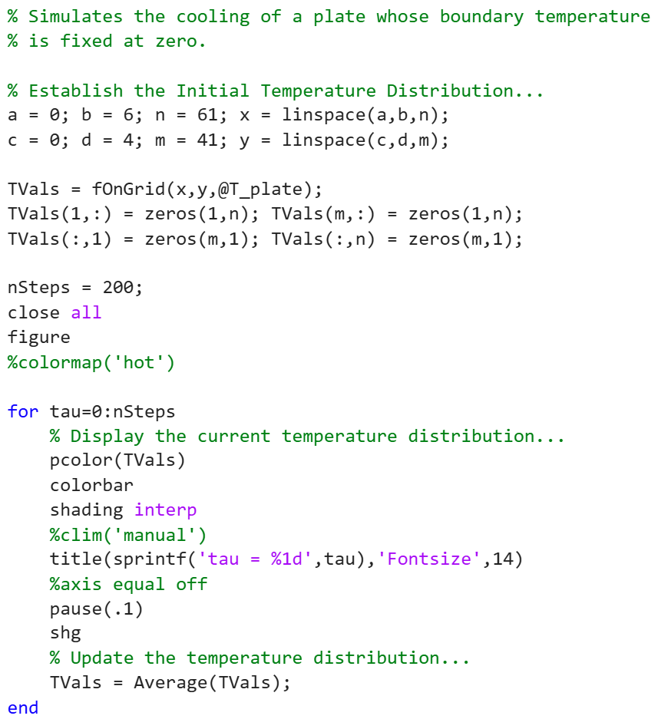
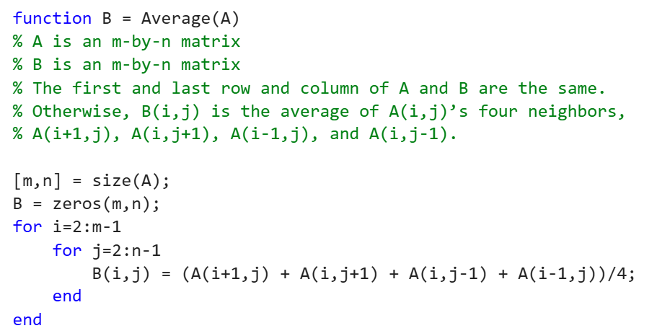
Final Code

Slide 53
Program Development
To graphically display the temperature distribution that is encoded in TVals, we use the function pcolor. This function essentially displays a matrix by color-coding each entry according to a color map. With a color map, a speciﬁc color is associated with real numbers in a certain interval.
To produce a smooth display of the temperature variation, we use shading interp (interpolation).
The colorbar adds a relationship between the data (temperature) and color for ease of identification.

Slide 54
Talking Point: Simulation on a Grid
The modeling of a physical phenomenon over a geometric region almost always proceeds by reporting relevant approximations on a grid. Accuracy usually improves as more mesh points are included. If the situation is evolving with time, then another attribute of the discretization is the “time step.” Again, accuracy usually improves if shorter time steps are taken.
The penalty for smaller Δx’s, Δy’s, and Δt’s is added work. In our problem, if we halve the grid spacing, then the amount of work associated with a call to Average is quadrupled. In actual applications there may be millions of grid points, especially in three-dimensional problems. The bottom line is that it is important to choose the discretization parameters intelligently so that accuracy requirements are met with a minimum of work.

Slide 55
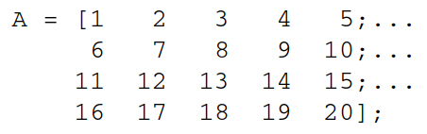
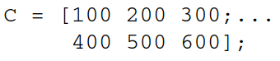
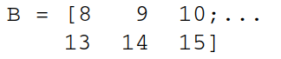
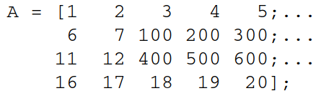
MATLAB Review: Submatrices
Using the colon notation it is possible to extract and modify subarrays. For example, if
then B = A(2:3,3:5) is the same as:
If matrix C is
and A(2:3,3:5) = C, then

Slide 56
MATLAB Review:
If A is a matrix, then pcolor(A) displays A as a color-coded mosaic of tiles. The color-coding is deﬁned by the current color map which can be set to a number of predeﬁned possibilities, e.g., colormap(’hot’), colormap(’cool’), etc.
Ordinarily, pcolor will display the matrix with visible tiles. For a “smoother” display of the color variation, execute the command shading interp.

Slide 57
Questions?

